Slide 1
PRE-TRAINED SUMMARIZATION DISTILLATION
https://arxiv.org/pdf/2010.13002v2.pdf

Slide 2
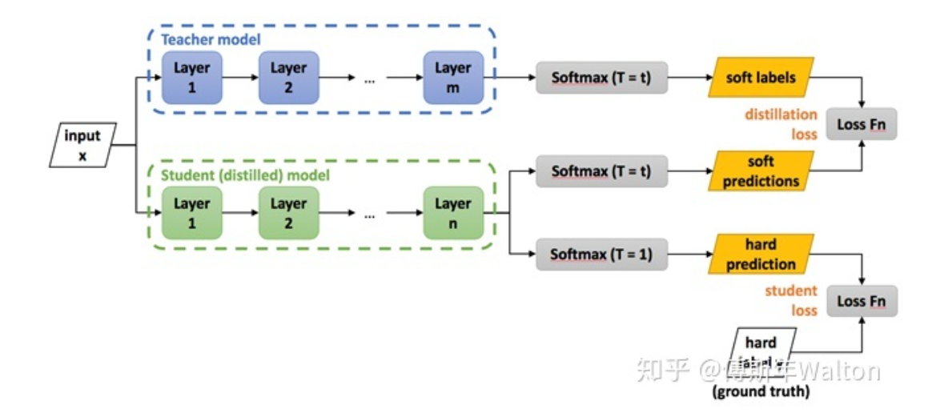
knowledge distillation
In machine learning, knowledge distillation is the process of transferring knowledge from a large model to a smaller one.
-wikipedia
KD: direct knowledge distillation
PL: pseudo-labeling
About Alcon Alcon is the global leader in eye care. As a division of Novartis, we offer the broadest portfolio of products to enhance sight and improve people's lives. Our products touch the lives of more than 260 million people each year living with conditions like cataracts, glaucoma, retinal diseases and refractive errors, and there are millions more who are waiting….
teacher
About Alcon Alcon is the global leader in eye care. As a division of Novartis, we offer the broadest portfolio of products to enhance sight and improve people's lives.
Generate summary
SFT: shrink and fine-tune
Example:
Raw model: 12–12
shrink model: 12-6/12-3/6-6
finetune

Slide 3
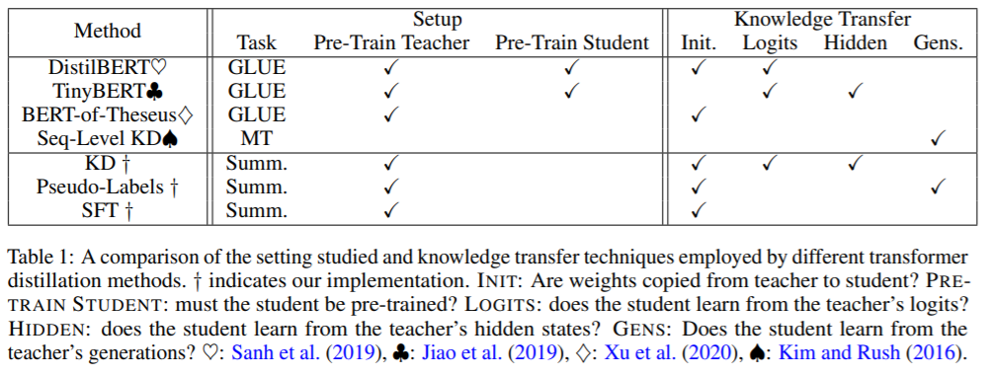
Comparison of Settings

Slide 4
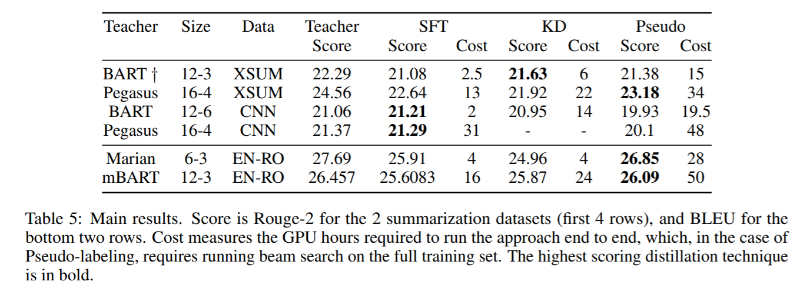
Main results

Slide 5
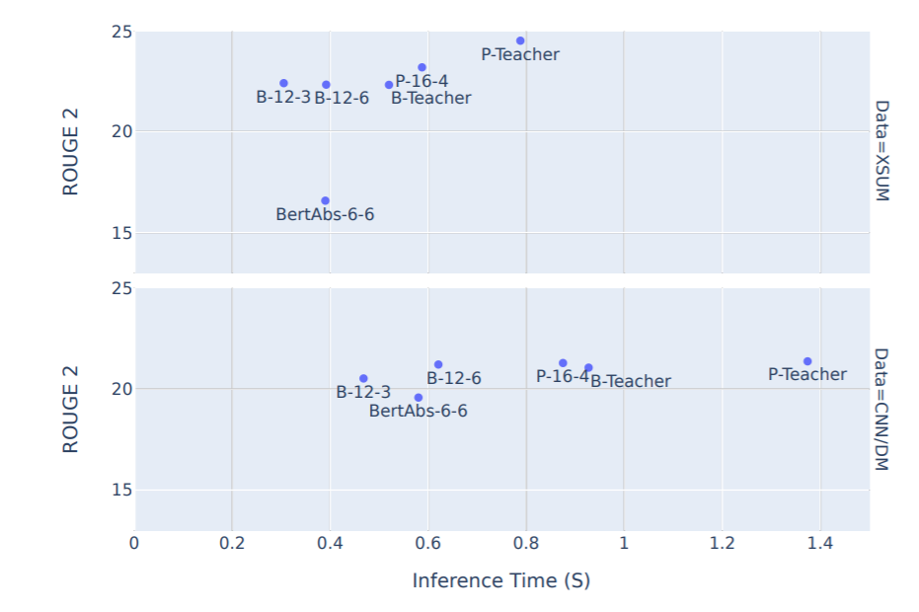
Main results

Slide 6
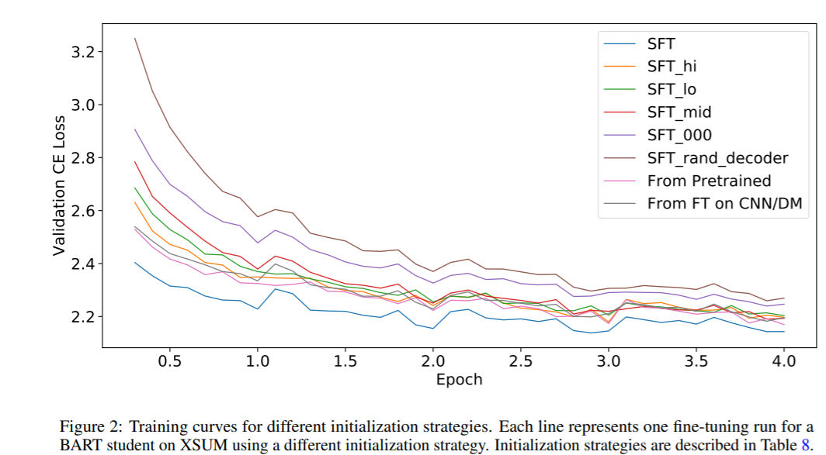
How to initialize
SFI: 0,3,11

Slide 7
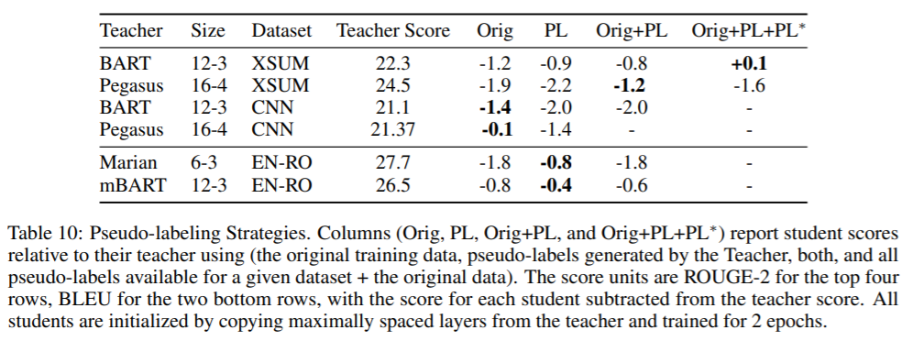
How to choose PL

Slide 8
Conclusion
This suggests that more work is needed for adapting KD approaches that work on BERT to Seq2Seq tasks, and that practitioners should try SFT first, followed by pseudo-labeling.

